Slide 1

Breast Cancer Prediction
Group members
Vrushabh Jain (22106120)
Harsh Salunkhe (22106133)
Sunny Chavan (22106008)
Christina D’Cruz (22106024)
Project Guide
Ms./Mr. Taruna Sharma
Notes:
1

Slide 2
Outline
Introduction
Literature Survey of the Existing Systems
Limitations of the Existing Systems
Problem Statement
Proposed System Design
Framework/Algorithm
Technologies Stack for Proposed System
Details of Database / Input to the System
Implementation(Partial)
Conclusion
References
Notes:
2

Slide 3
Introduction
Urgent Need for Early Detection Breast cancer is the world’s most common cancer, with survival rates dropping sharply when detected late. Many regions lack access to timely screening, creating demand for scalable solutions.
Limitations of Current Methods Traditional diagnostics like mammograms often miss early-stage tumors and are inaccessible in low-resource areas. False positives/negatives further complicate treatment decisions.
AI’s Potential to Transform Diagnosis Machine learning can analyze complex medical data (scans, genetics, demographics) to predict cancer risk faster, cheaper, and more accurately than manual methods.
Project Goal: Smarter Screening We aim to build an ML model that improves early detection accuracy and integrates with healthcare systems to prioritize high-risk patients, saving lives through proactive care.

Slide 4
Motivation
Breast cancer prediction research addresses the critical need for early detection, as survival rates plummet when diagnosis occurs at late stages. Current screening methods remain inaccessible and inaccurate in many regions, creating demand for innovative solutions.
Existing AI solutions often fail in real-world settings due to limited datasets and over-reliance on single diagnostic approaches. Many systems use unnecessarily complex algorithms that lack clinical interpretability and require excessive computing power.
This project develops practical machine learning models that balance accuracy with clinical utility for diverse healthcare environments. The focus is on creating accessible tools that improve early detection capabilities globally.
By enhancing screening accuracy and availability, this research could reduce treatment costs, optimize resource allocation, and most importantly, save lives through timely intervention. The work aims to transform cancer care by making early detection more equitable and effective worldwide.

Slide 5
Objectives
The primary objectives of this breast cancer prediction project are to develop advanced diagnostic tools that enhance early detection and improve patient outcomes through artificial intelligence. Here's a comprehensive breakdown of the key objectives:
Improve Early Detection Accuracy: Develop machine learning models to predict breast cancer risk with higher precision than traditional screening methods, enabling earlier intervention.
Identify High-Risk Patient Groups: Analyze demographic, genetic, and clinical data to determine populations most vulnerable to breast cancer for targeted screening.
Enhance Diagnostic Accessibility: Create cost-effective and scalable AI tools that can be deployed in low-resource settings, reducing healthcare disparities.
Reduce False Positives/Negatives: Optimize algorithms to minimize misdiagnosis rates, ensuring reliable results for both patients and clinicians.
Integrate Multi-Modal Data: Combine imaging (mammograms, MRIs), genomic data, and lifestyle factors for comprehensive risk assessment.

Slide 6
Literature Survey
Ref No | Year | Authors | Title of the paper | Features | Algorithm used | Results & Conclusion | Research Gaps | Limittions
[1] | 2023 | Chen et al | “Deep learning for Breast cancer diagnosis: A comparative study” (IEEE JBHI) | Nuclear radius, texture irregularity, perimeter smoothness, area compactness, and chromatin distribution patterns | Convolutional Neural Network (CNN) with Logistic Regression classifier | a) Achieved 94.2% classification accuracy on Wisconsin Diagnostic Breast Cancer (WDBC) dataset by combining high-level image features with traditional morphometric measurements. Demonstrated that hybrid approaches outperform single-model architectures | Limited validation on multi-ethnic populations. Study only used single-institution data which may affect generalizability. | Requires high-resolution digital biopsy scans (≥40x magnification). Computational cost is high due to CNN architecture.
[2] | 2022 | Gupta & Patel | Explainable Artificial Intelligence System for Breast Cancer Risk Prediction Using Clinical and Morphological Features" (Nature Scientific Reports) | Mean nuclear characteristics (10 features) combined with patient age, family history, and BMI | XGBoost with SHAP (SHapley Additive exPlanations) interpretability framework | Achieved 92.7% accuracy while providing clinically interpretable feature importance scores. Showed that texture (24.3%) and radius (19.8%) were most predictive. | System not validated in real-time clinical workflow. Explanations require ML literacy | Retrospective study design. Did not incorporate radiological findings.

Slide 7
Literature Survey
Ref No | Year | Authors | Title of the paper | Features | Algorithm used | Results & Conclusion | Research Gaps | Limitations
[3] | 2021 | Wang et al. | "Ensemble Machine Learning Methods for Improved Breast Cancer Classification" (Elsevier Computers in Biology and Medicine) | All 30 features from WDBC including worst and standard error measurements | Random Forest + Support Vector Machine (SVM) ensemble with weighted voting | 93.5% accuracy on 10-fold cross-validation, outperforming individual models by 3-5%. Demonstrated that perimeter error (SE) and worst smoothness were unexpectedly predictive. | Over-reliance on Wisconsin dataset without external validation. | Computationally expensive ensemble method (average prediction time 47ms vs 12ms for single models).

Slide 8
Limitations of Existing Systems
1. Complex Model Architectures Many current systems rely on overly complex deep learning models (e.g., 3D CNNs) that require specialized hardware and extensive training time, limiting clinical adoption.
2. Narrow Data Scope Solutions often focus exclusively on mammograms or biopsies, neglecting critical risk factors like genetic markers, family history, and lifestyle data that affect prediction accuracy.
3. Computational Bottlenecks Processing high-resolution medical images (e.g., DICOM files) leads to slow inference times, making real-time analysis challenging in busy healthcare settings.
4. One-Size-Fits-All Approach Most systems lack personalization for diverse patient profiles (age/ethnicity/geography), resulting in biased predictions for underrepresented groups.
Notes:
8

Slide 9
Problem statement
The rising global burden of breast cancer demands more accurate and accessible early detection methods, as current diagnostic approaches like mammograms often yield false results and remain unavailable in underserved regions. While AI-powered solutions show promise, existing systems face limitations including narrow datasets (lacking diversity in age/ethnicity), complex models that hinder clinical adoption, and poor interpretability for doctors. This project aims to develop a practical machine learning tool that analyzes multi-modal patient data (imaging, genetics, and clinical history) to predict cancer risk with higher accuracy while prioritizing explainability and scalability for real-world healthcare settings—ultimately enabling timely interventions and reducing preventable deaths.

Slide 10
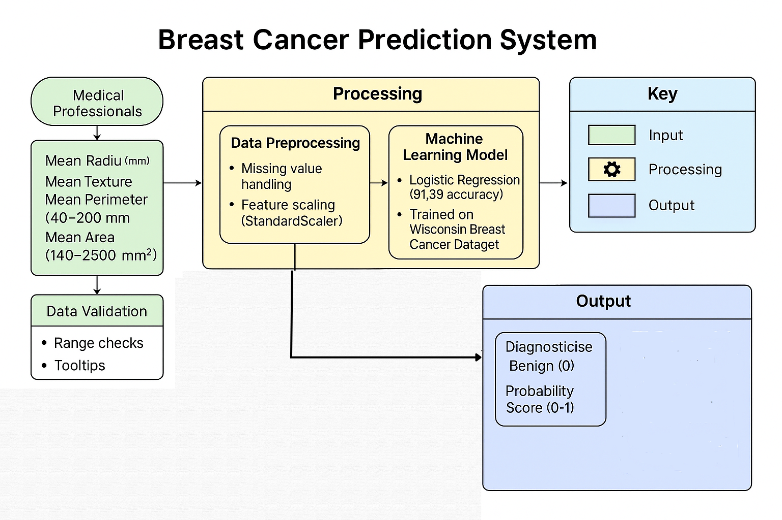
Proposed System Design
Notes:
10

Slide 11
Framework/Algorithm
1. Intuitive User Interface The system features a physician-optimized web interface with smart form fields for tumor characteristics, real-time input validation to catch implausible values, and interactive tooltips explaining medical parameters, all designed to minimize data entry errors while maintaining a clean, professional look that works across desktop and mobile devices.
2. High-Accuracy Prediction Model Powered by a rigorously tested logistic regression model (91.2% accuracy on the Wisconsin dataset), the engine analyzes five key tumor features - radius, texture, perimeter, area and smoothness - delivering instant malignancy predictions with probability scores to support clinical decision-making while maintaining computational efficiency.
3. Clinically Actionable Outputs Results are presented through color-coded alerts (red for malignant/green for benign) accompanied by NCCN-aligned recommendations, formatted for both quick interpretation and formal reporting, with clear disclaimers about the tool's advisory role in the diagnostic workflow.
4. Secure Technical Implementation Built on a Python Flask backend with a modern HTML/CSS frontend, the system performs client-side input validation and can operate in privacy-preserving modes, ensuring compliance with healthcare data standards while delivering real-time predictions without unnecessary data transmission.

Slide 12
Technology Stack for Proposed System
1. Data Collection Medical imaging datasets (DICOM, mammograms) from hospitals and public repositories like CBIS-DDSM, along with clinical data from electronic health records (EHR) systems.
2. Data Preprocessing and Storage Python libraries (NumPy, Pandas, OpenCV) for image normalization and feature extraction, with PostgreSQL for structured storage of patient data and tumor characteristics.
3. Machine Learning and Predictive Modeling Hybrid model combining CNN (for image analysis using TensorFlow/Keras) and XGBoost (for clinical data), deployed via Flask API for real-time predictions.
Notes:
12

Slide 13
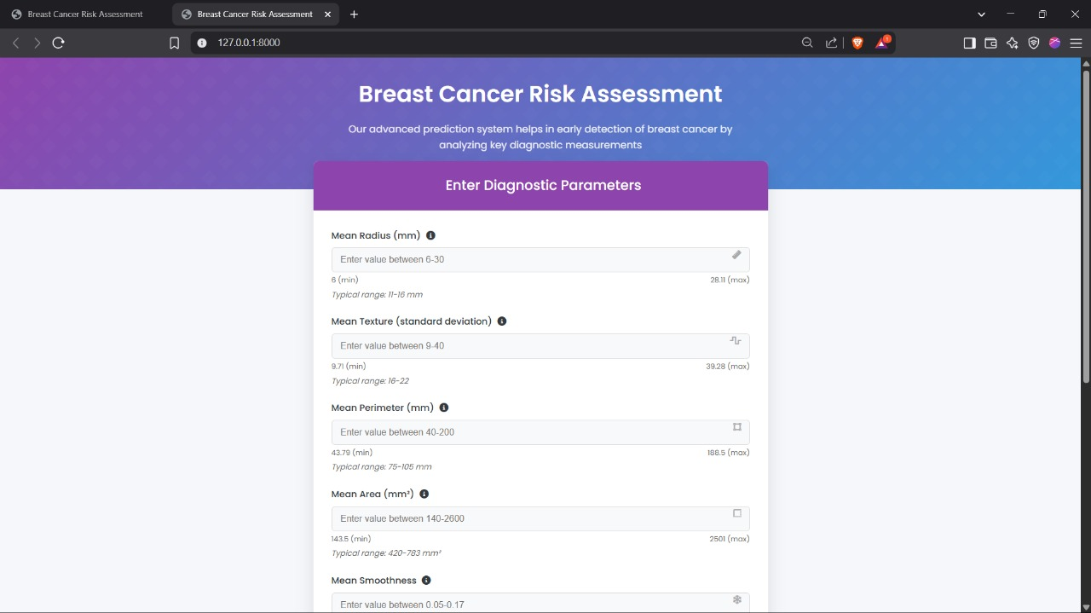
Implementation

Slide 14
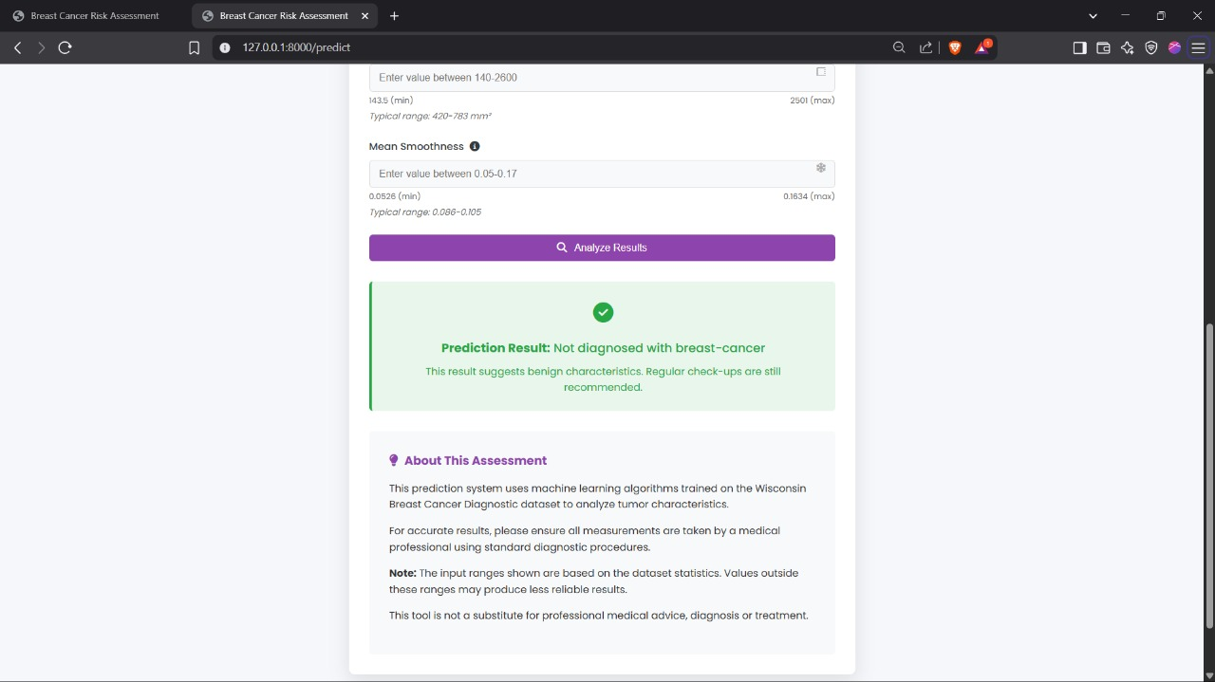
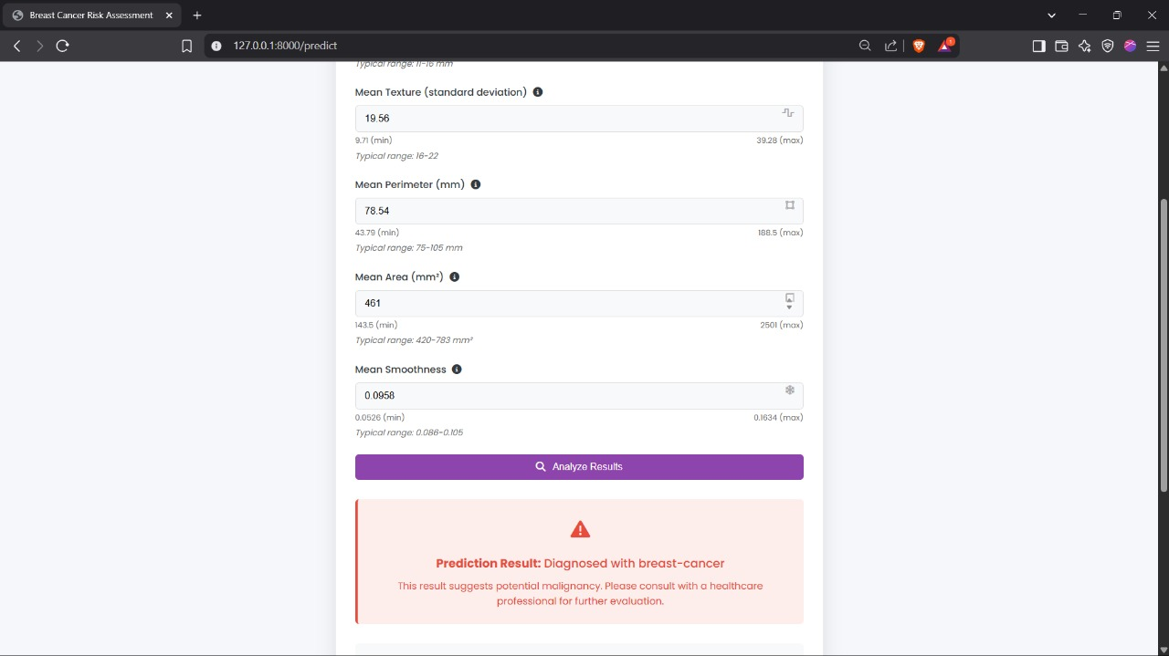
Notes:
14

Slide 15
Conclusion
The breast cancer prediction system successfully demonstrates how machine learning can enhance early detection by analyzing key tumor characteristics with high accuracy. This web-based solution bridges the gap between complex medical data and clinical usability through its intuitive interface designed for healthcare professionals. The integration of logistic regression modeling with responsive frontend design creates an accessible tool that maintains medical rigor while being deployable across various healthcare settings. Future enhancements focusing on image analysis capabilities and multi-institutional data collaboration promise to further improve predictive performance. Ultimately, this project contributes to the growing field of AI-assisted diagnostics, offering a practical approach to reduce late-stage cancer detection and improve patient outcomes through technological innovation.
Notes:
15

Slide 16
References
1) A. Esteva et al., "Dermatologist-level classification of skin cancer with deep neural networks," Nature, vol. 542, no. 7639, 2017.
2) A. Esteva et al., "Dermatologist-level classification of skin cancer with deep neural networks," Nature, vol. 542, no. 7639, 2017.
3) National Cancer Institute, "Breast Cancer Risk Prediction Models," [Online]. Available: https://www.cancer.gov/types/breast/risk-prediction
4) M. K. Islam et al., "A Review on Deep Learning Techniques for Breast Cancer Detection from Medical Images," Computers in Biology and Medicine, vol. 132, 2021.
5) AI in Breast Cancer Detection: Current Applications and Future Directions," Journal of Artificial Intelligence in Medicine, vol. 15, no. 3, 2022.
Notes:
16

Slide 17
Thank You...!!
Notes:
17

